Slide 1



22nd November 2025, Buea

Slide 2

BUILDING A SERVERLESS DATA PIPELINE ON AWS:
A Case Study from Cameroon

Slide 3



TENGU Quinter
AWS Solution Architect Instructor @ Trustech Online University
Founder & CEO: Elegancia Cakes & Treats
My Socials
LinkedIn: Tengu Quinter
Facebook: Quinter T Munah
Facebook: Elegancia Cakes and Treats
IG: Royal Elegancia Cakes

Slide 4






As a mom of 4, I'm highly aware of how easy it is to miss critical vaccination dates and I’m guilty of that.

Slide 5

We still have to get it.

Slide 6

The Challenge
Manual tracking of health records including vaccination records are prone to errors which can have life altering consequences.

Slide 7

Problem Solved
A Serverless Data Pipeline digitizes patient schedule, thereby replacing manual checks and ensuring proactive, timely, life-saving vaccination.

Slide 8

Problem Solved
A Serverless Data Pipeline digitizes patient schedule, thereby replacing manual checks and ensuring proactive, timely, life-saving vaccination.

Slide 9
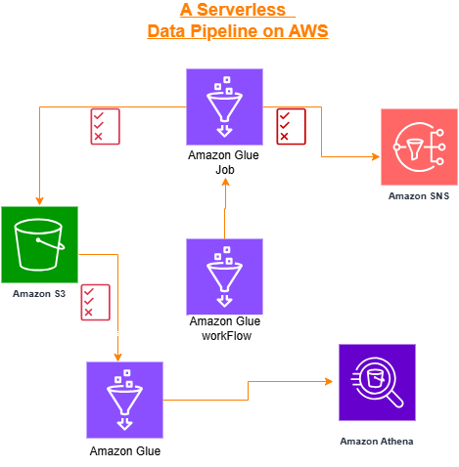

Slide 10

How It Works: the Pipeline Flow
Data Ingestion: A healthcare worker uploads a CSV file containing patient data to an S3 bucket.
Automated Processing: A Glue Workflow triggers a Glue Job on a daily schedule.
ETL: The Glue Job processes the data, identifying babies with near due vaccinations.
4. Proactive Notifications: The Glue Job publishes two separate messages to an SNS topic, one for babies ready for vaccination and another if there are no babies due for vaccination.

Slide 11
How It Works: the Pipeline Flow
5. Email Reminders: SNS delivers these messages to the subscribed Public Relations Officer (PRO) via email.
6. Data Analysis: The PRO or other stakeholders can use Athena to run SQL queries or create a dashboard in QuickSight to analyze vaccination trends and forecasts.

Slide 12

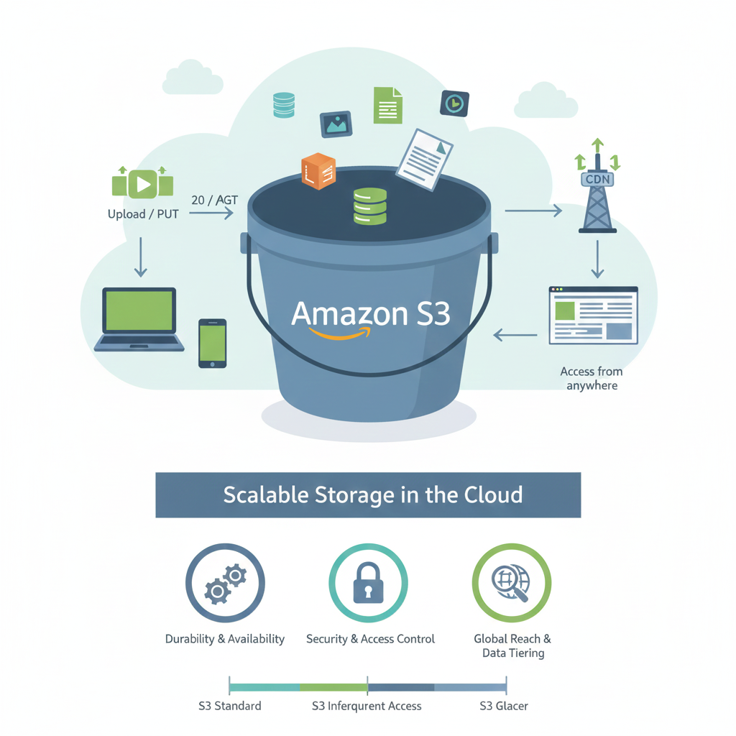
AWS Services: A Deep Dive

Slide 13
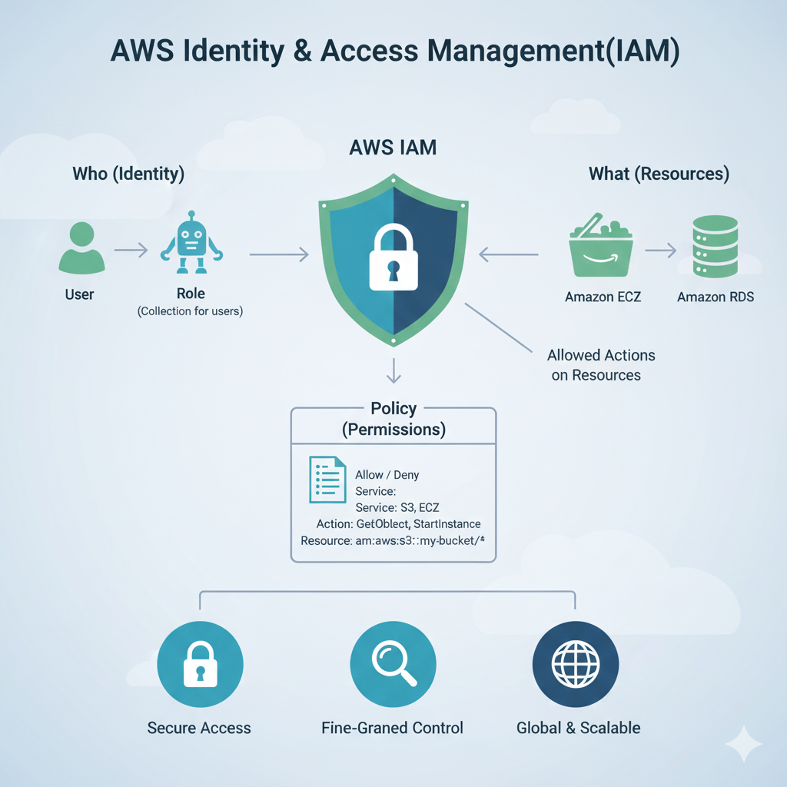
AWS Services: A Deep Dive

Slide 14
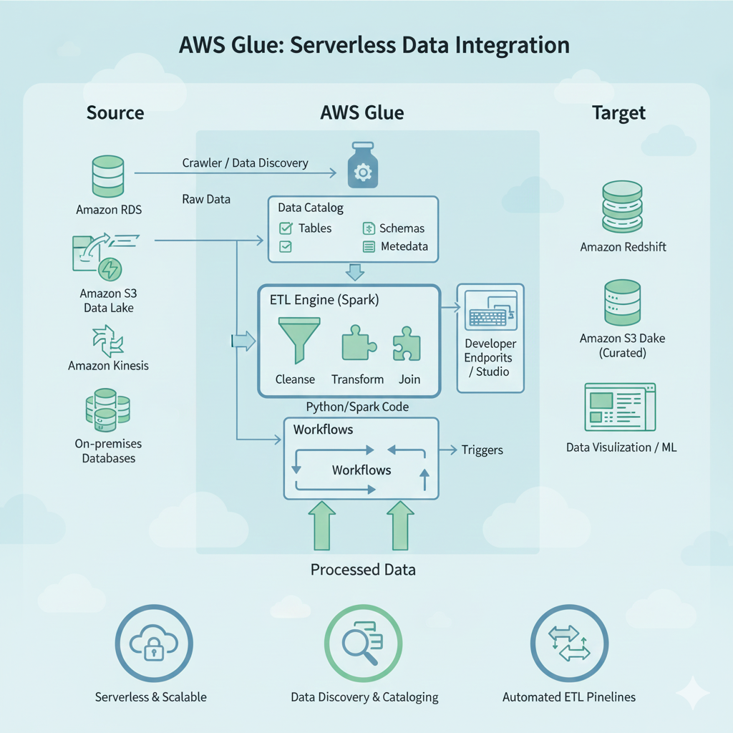
AWS Services: A Deep Dive

Slide 15
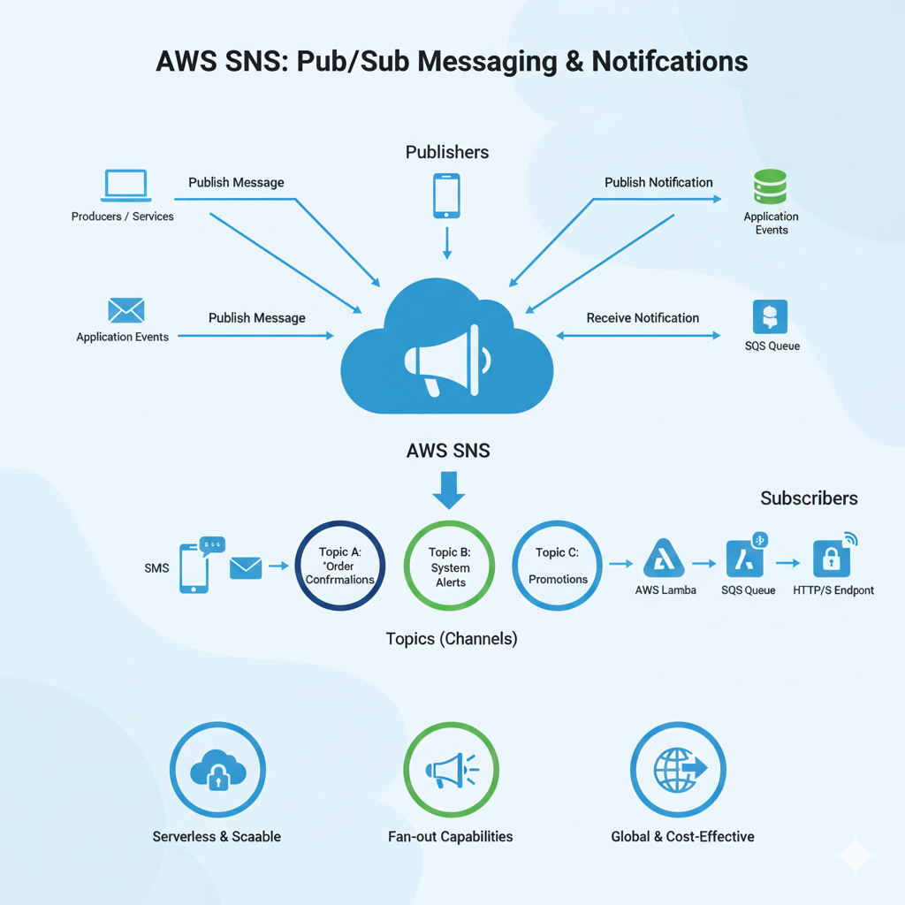
AWS Services: A Deep Dive

Slide 16
SETUP AND INSTRUCTIONS
STEP 1: DATA AND STORAGE 📁
Preparing Our Dataset
Create an S3 Bucket:
Go to Amazon S3 and create a new bucket.
Name it descriptively (e.g., vaccination-data-2025).
Upload the File:
Upload the vaccination records gotten from the hospital to the S3 bucket.
Name it descriptively (e.g., vaccination-records-2025).

Slide 17
STEP 2: NOTIFICATIONS 🔔
Setting up a Channel for Reminders
Create an SNS Topic:
Go to Amazon SNS and click Create topic.
Name: pro-vaccination-reminders.
Type: Standard.
Add an Email Subscription:
Within the topic, click Create subscription.
Protocol: Email.
Endpoint: pro@example.com (add PRO’s email).
Confirm Subscription: The PRO must check their email
and click the confirmation link.

Slide 18
STEP 3: THE GLUE JOB 💻
The Engine of Our Pipeline
Create IAM Role: Glue Role
Attach policies for S3, SNS, and CloudWatch access.
Attach the AWSGlueServiceRole managed policy.
Modify the Glue script:
Copy your S3 Bucket Name,Key(csv file name) and SNS Topic ARN and paste on the Glue script
Create the Glue Job:
Go to AWS Glue > Jobs.
Select Script editor.
Type: Spark (critical for pyspark).
Uplaod script from your pc and create script.

Slide 19
STEP 3: THE GLUE JOB 💻
Go to Job details and entire the details.
Name: vaccination-reminder-job.
IAM Role: Select the role you created.
Language: python 3
Script Path: s3://your-bucket/glue_script.py.
Worker Type: G.1X.
Workers: 2. we don’t need the default 10 workers for this job.
Leave other default configurations and save.
You can test the job by running it manually.

Slide 20
STEP 4: THE TRIGGER ⏰
The Daily Scheduler
Create Glue Workflow:
Go to AWS Glue > Workflows.
Click Add workflow.
Name: vaccination-reminder-workflow.
Create the Trigger:
Add a trigger to your workflow.
Schedule Type: Scheduled.
Frequency: choose Custom and add rate(5 minutes) OR Cron Expression: 0/5 * * * ? *.
Add Node: Connect your vaccination-reminder-job to this trigger.
Start the Workflow: The workflow will now automatically execute the job every 5 minutes. In real life it will be daily.

Slide 21
STEP 5: DATA ANALYSIS WITH ATHENA 📊
Insights from Our Data
Create a Glue Crawler:
Go to AWS Glue > Crawlers.
Point it to your S3 bucket.
Create an IAM Role add GlueServiceRole as well as S3BucketFullAccess
Create the database vaccination-Reminder-db.
Run the crawler to create the table vaccination_records.

Slide 22
STEP 5: DATA ANALYSIS WITH ATHENA 📊
Query Your Data:
Open the Table your crawler created,
Click on Action and click view data
Click Proceed
Go to settings and add an S3 bucket as your query result location.
Run queries to get insights, like finding specific babies to view their records.
SELECT
* FROM "AwsDataCatalog"."etl-db"."vaccination_data_2025"
WHERE
"col0" IN ('Agnes Beye', 'Bella Mballa', 'Samir Ngono');

Slide 23


TROUBLESHOOTING 💡
Common Issues and Solutions
ModuleNotFoundError: No module named 'pyspark'
Fix: Ensure your Glue job Type is Spark, not Python Shell.
TABLE_NOT_FOUND
Fix 1: Verify your Glue crawler is pointing to the correct S3 path
(e.g., s3://bucket/, not s3://bucket/file.csv).
Fix 2: In Athena, ensure the database dropdown is set to the correct
database (e.g., vaccine-db2).
Fix 3: Check for typos in the database or table name.

Slide 24
Delete all resources you created to save cost.

Slide 25
THANK YOU

